Slide 1
Supply Management and Commodity Strategy Development
Chapter 6

Slide 2
Chapter Overview
Aligning supply management and enterprise objectives
What is a category strategy?
Category strategy development
Types of supply management strategies
E-reverse auctions
Evolving sourcing strategies

Slide 3
Theme of this lecture
How do organizations strategically manage their suppliers and spending to gain a competitive advantage?

Slide 4
Why Apple Invests Billions to Diversify Chip Suppliers
Spend Analysis:
TSMC (Taiwan Semiconductor Manufacturing Company) manufactures approximately 25% of Apple's chips (estimated from Apple's total chip needs)​
Apple also concentrates final assembly in China through Foxconn - over 80% of iPhone production happens there​.
This creates a single-point-of-failure risk in critical commodities (semiconductors and manufacturing services)

Slide 5
Apple Strategic Response (2024-2025)
Investing $1+ billion annually in supply chain diversification​
Moving chip production to the U.S. (Intel partnerships) and South Korea (Samsung)​
Bringing manufacturing to India, Vietnam, and Mexico
Why?
Geopolitical risk + supplier concentration risk

Slide 6
Aligning Objectives
What markets will the firm compete in, and on what basis?
What are the long-term and short-term business goals?
What are the budgetary and economic resource constraints, and how will these be allocated to functional groups and business units?

Slide 7
How Companies Make Money
Raise prices
1. Increase revenues
Increase volume
Reduce cost of employees
2. Decrease costs
Reduce cost of processes/waste
Reduce cost of goods/services

Slide 8
Integrative Strategy Development
Corporate strategy
Business unit strategy
Supply management strategy
Commodity strategy

Slide 9
Integrative Strategy Development
Corporate strategy
  Definition of businesses in which to participate
  Acquisition and allocation of resources to those businesses
Business unit strategy
  Scope or boundaries of those businesses
  Basis of competitive advantage

Slide 10
Integrative Strategy Development
Supply management strategy
  Support the desired competitive business-level strategies
  How to complement other functional areas
Commodity strategy
  How to purchase commodities to support higher-level strategies

Slide 11
Components of Integrative Strategy
Company objectives
Cross-functional business objectives
Purchasing and supply chain goals
Purchasing and supply chain strategies
Performance measurement system
Performance measurement review
Continuous improvement

Slide 12
Translating Objectives→ Goals
Cost reduction objectives → goals
  Be low-cost producer in industry
    Reduce material costs by 15%
  Reduce levels of inventory required to supply internal customers
    Reduce raw material inventory ≥ 20 days’ supply

Slide 13
Translating Objectives→ Goals
Technology/new product development objectives → goals
  Outsource non-core competency activities
    Qualify 2 new suppliers by end of year
  Reduce product development time
    Develop a formal supplier integration process manual by 12/31

Slide 14
Translating Objectives→ Goals
Supply base reduction objectives → goals
  Reduce the number of suppliers used
    Reduce the supply base by 30% in next 6 months
  Joint problem solving with remaining suppliers
    Identify $300,000 in cost savings with 2 suppliers by end of fiscal year

Slide 15
Translating Objectives→ Goals
Supply assurance objectives → goals
  Assure uninterrupted supply from identified suppliers
    Reduce order cycle time on key parts ≥ 1 week
Quality objectives → goals
  Increase quality of services and products
    Reduce average defects by 200 ppm on all receipts in next fiscal year

Slide 16
Enabling Effective Category Strategies
Spend money on resources initially, including assessment of current spend, data collection, market research, training, and people
Validate savings or contributions to other company objectives achieved by supply management and drive them to the bottom line

Slide 17
Enabling Effective Category Strategies
Sustain the initiative through presentations to senior executives who support the move towards an integrated supply management function with other functional groups in the supply chain.

Slide 18
Conducting a Spend Analysis
What did the business spend its money on over the past year?
Did the business receive the right amount of products and services given what was paid for them? (S/OX issue)
What suppliers received the majority of the business?

Slide 19
Conducting a Spend Analysis
Did the suppliers charge an accurate price across all divisions vs. P.O. requirements, contracts, and SOWs?
Which divisions spent their money on products and services that were correctly budgeted for?
Are there opportunities to combine volumes and standardize purchases?

Slide 20
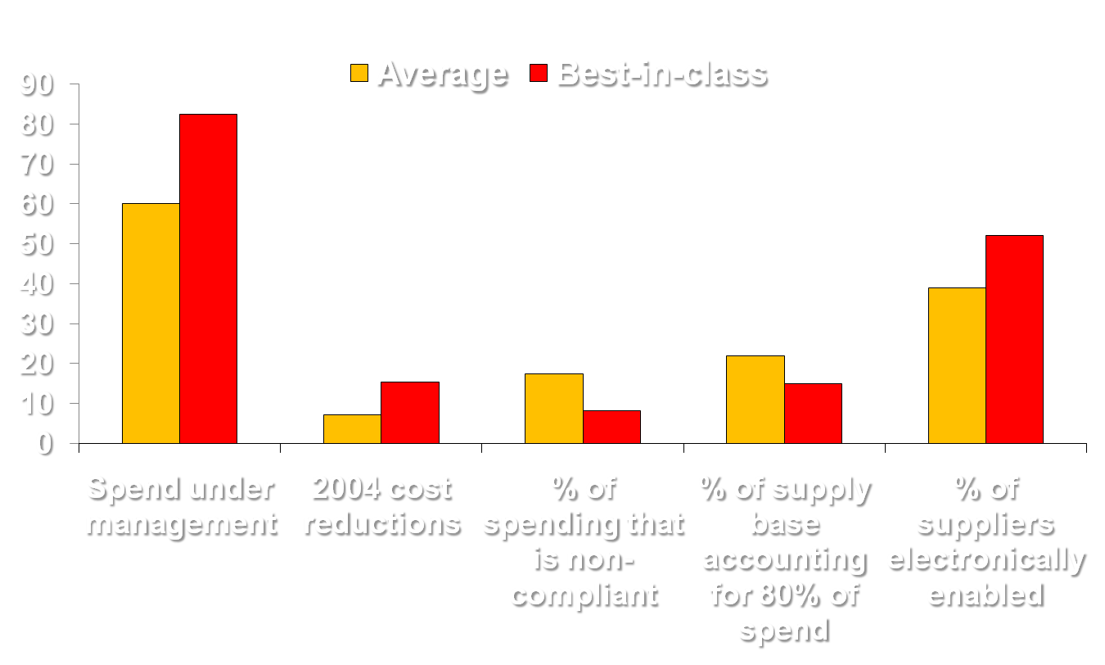
Procurement KPIs Example
%

Slide 21
Spend Analysis Spreadsheet
Sort by commodity
Find total spend by commodity
Chart top 10 in descending $ amount
Sort by number of suppliers/commodity
Chart top 10 by descending # of suppliers
Find average spend/supplier/commodity
Apply Pareto analysis for opportunities

Slide 22
Sample Spend Categories
Supplier | Commodity | Annual Spend
Rebate Company | Rebate fulfillment & call center | $329,873,663
Invest Company | Investments | $130,328,512
Advert Company | Advertising | $56,134,490
Repair Company | Service repairs | $49,339,218
Benefits Company | Benefits | $48,969,149
Hardware Company | Hardware | $40,572,450
Partco | Service parts | $39,910,372
Telecom | Telecommunications | $31,055,599
Display Company | Store displays | $30,020.969
Penpaper Company | Paper | $29,175,843
Labor Company | Contract labor | $27,880,363
Supply Company | Paper | $23,844,707
Contract Company | General contracting | $22,579,113
Office Company | Paper | $22,257,690
Graphics Company | Graphic design | $21,966,989
Payment Company | Business & management services | $20,380,275
Freight Company | Surface freight | $19,369,010
Paper Company | Paper | $15,603,682
Service Plan Company | Service plan | $15,478,827
Service Company | Service parts | $14,868,023
Consumer Company | Consumer financing | $14,833,333
Energy Company | Energy | $14,087,177

Slide 23
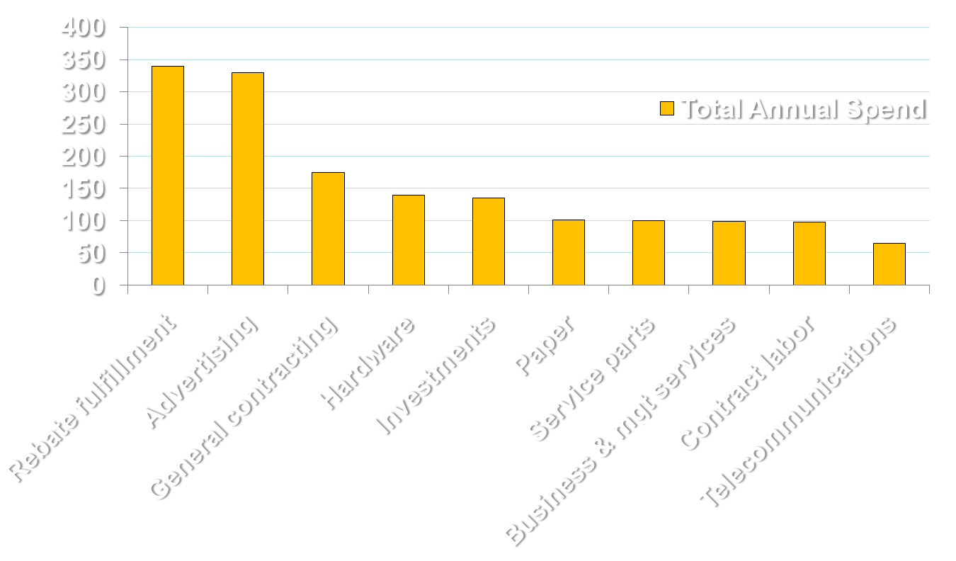
Spend by Commodity
Million $

Slide 24
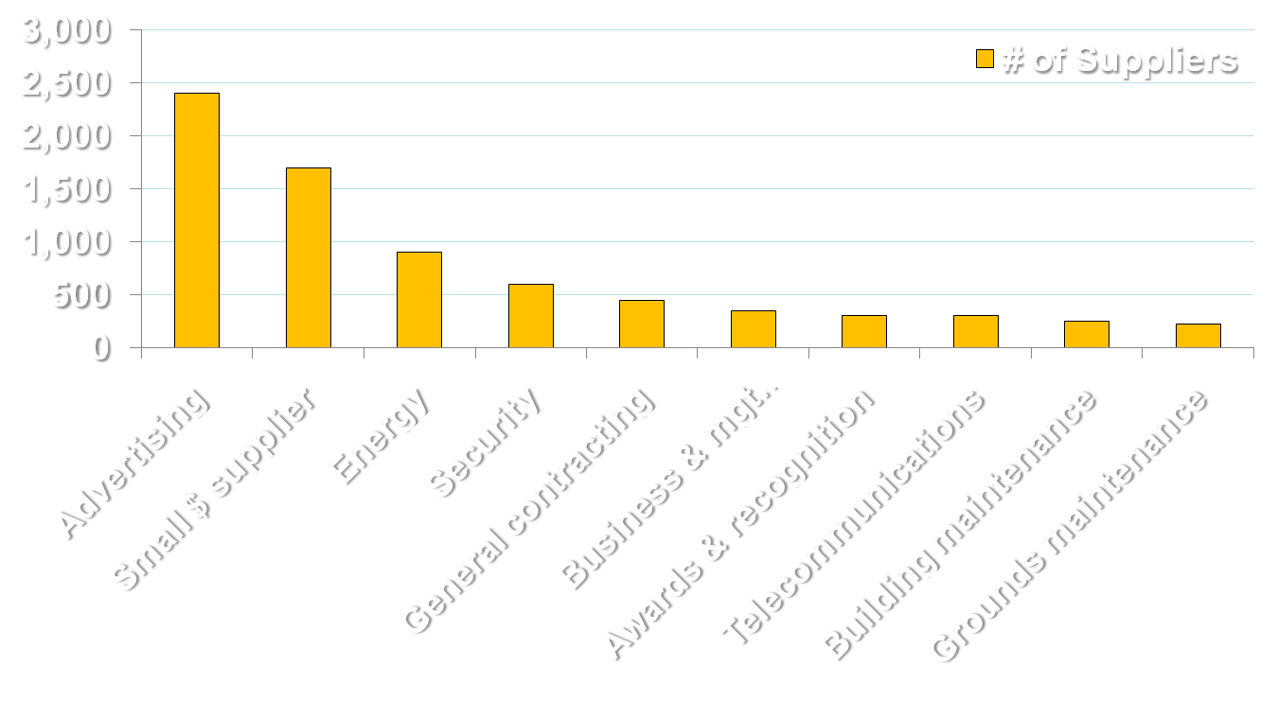
Suppliers by Commodity

Slide 25
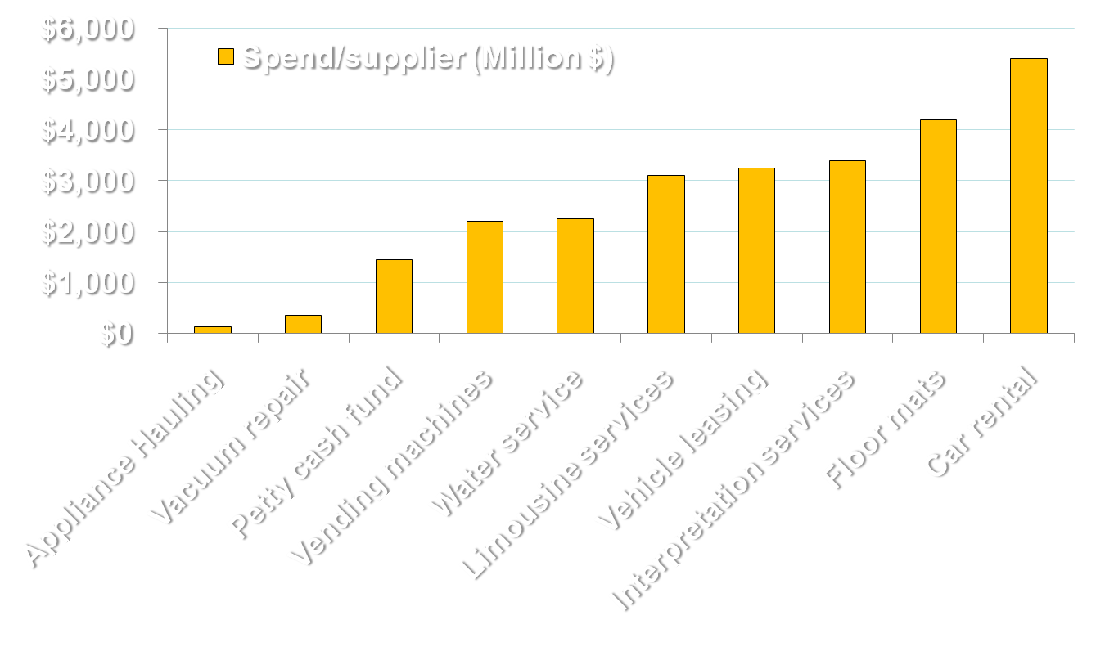
Spend/Supplier by Commodity

Slide 26
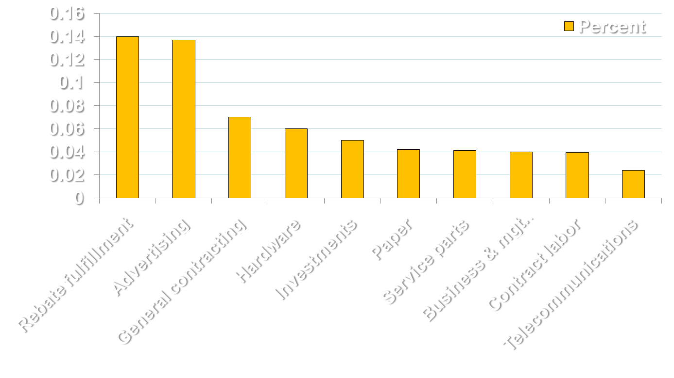
Percent of Total Spend

Slide 27
The Strategic Sourcing Process
Step 1
Build the Team
Step 2
Market Research
Step 5
SRM
Step 3
Strategy Development
Step 4
Contract Negotiation
Goal: Develop a statement of work and plan | Goal: Understand the supply market | Goal: Classify suppliers and define sourcing approach | Goal: Negotiate a win-win contract | Goal: Continuously improve performance
Inputs and Tools: Project leader; other team members | Inputs and Tools: Interviews; online research; conferences | Inputs and Tools: Market research; portfolio matrix; forecasted spend | Inputs and Tools: Negotiation plan; supplier evaluation tool | Inputs and Tools: Contract; supplier scorecard
Outputs: Baseline data; project charter; work plan | Outputs: Report on supply trends; changes; pricing; capacity; etc. | Outputs: Supplier evaluation tool with desired relationship | Outputs: Signed contract | Outputs: Supplier development plan; communication

Slide 28
Step 1: Team and Project Charter
Identify key cross-functional team members
Define the scope of the category strategy
Publish a team charter
Develop a work plan and communication plan

Slide 29
Step 2: Conduct Market Research
Understand the purchase requirement relative to business unit objectives
Conduct thorough spend analysis
Identify specific internal users
Identify current suppliers
Research supply marketplace

Slide 30
Step 2: Conduct Market Research
Information required
  Total annual purchases
  Interviews with stakeholders
  External market research
Key suppliers | Available capacity | Technology trends
Price data and trends | Cost data and trends | Technical requirements
Environmental issues | Regulatory issues | Other available data

Slide 31
Step 2: Conduct Market Research
Triangulation – explore, compare, and contrast data from multiple sources
Trade journals | Annual reports | Internet | Books
Snow-ball sampling | Trade consultants | Category managers | Headlines
Suppliers | Investment reports

Slide 32
Step 2: Conduct Market Research
Porter’s Five Forces Model
SWOT analysis
Establish benchmarks through industry databases
Requests for information
Value chain analysis
Supplier research

Slide 33
Porter’s Five Forces Model
Threat of New Entrants
Supplier Bargaining Power
Market Internal Competition
Buyer Bargaining Power
Pressure from Substitutes
Other possible forces:
Globalization
Digitization
Deregulation
Source:
Competitive Strategy
Michael E. Porter (1980)

Slide 34
Market Internal Competition
Speed of industry growth
Capacity utilization
Exit barriers
Product differences
Switching costs
Diversity of suppliers

Slide 35
Threat of New Entrants
Capital markets
Availability of skilled workers
Access to critical technologies, inputs, or distribution
Product life cycles

Slide 36
Threat of New Entrants
Brand equity and customer loyalty
Government deregulation
Risk of switching
Economies of scale

Slide 37
Pressure from Substitutes
Relative performance of substitute products and services
Relative price
Switching costs
Buyer’s propensity to switch

Slide 38
Buyer Bargaining Power
Buyer concentration
Buyer volume
Buyer switching costs
Price sensitivity
Product differences

Slide 39
Buyer Bargaining Power
Brand identity
Impact on quality or performance
Buyer profits
Availability of substituttes

Slide 40
Supplier Bargaining Power
Price of major inputs
Ability to pass along price increases
Availability of key technologies or other resources
Threat of forward or backward integration
Industry capacity utilization
Supplier concentration
Importance of volume to supplier

Slide 41
SWOT Analysis
Low product innovation
Traditional, unionized business processes
Low patent protection
Broad customer base
Established product range
Established distribution channels
Strengths | Weaknesses
Opportunities | Threats
Internal Factors
Emergence of other uses and markets
Emerging overseas markets
High entry barriers
Emerging overseas suppliers
NPD costs are high
Environmental regulations
External Factors

Slide 42
Benchmarks
Identify critical performance criteria
Identify relative competitive performance
Use of industry benchmarks
  CAPS
  Third party consulting firms

Slide 43
Requests for Information (RFIs)
Use before a specific requisition is issued
Use to obtain general information about services, products, or suppliers
  Does not constitute a binding document
Use when a large or complicated purchase is considered and when pool of suppliers must be prequalified

Slide 44
Supplier Research
Cost structure
Financial status
Customer satisfaction levels
Support capabilities
Relative strengths and weaknesses
Buyer’s fit with supplier
How the company is viewed
Core capabilities
Strategy/future direction
Culture

Slide 45
Step 3: Strategy Development
Portfolio analysis
  Critical commodity – strategic supplier
  Routine commodity
  Leverage commodity – preferred supplier
  Bottleneck commodity – transactional supplier
Process and design capabilities
Management capability

Slide 46
Step 3: Strategy Development
Financial condition and cost structure
Planning and control systems
Environmental regulation compliance
Longer-term relationship potential
Weighted point supplier evaluation systems

Slide 47
Portfolio Analysis
High
Bottleneck Commodity | Critical Commodity
Routine Commodity | Leverage Commodity
Complexity or Risk Impact
Low
Low
High
Value Potential

Slide 48
Critical Commodity
Critical to profitability and operations
Few qualified sources of supply
Large expenditures
Design and quality are critical
Complex and/or rigid specifications

Slide 49
Critical Commodity
Strategy
  Form partnership with suppliers
Tactics
  Increase role of selected supplier

Slide 50
Critical Commodity
Actions
  Heavy negotiation
  Supplier process management
  Prepare contingency plans
  Analyze market and competition
  Use functional specifications

Slide 51
Routine Commodity
Many alternative products and services
Many sources of supply
Low value, small individual transactions
Everyday use, unspecified items
Anyone could buy it

Slide 52
Routine Commodity
Strategy
  Simplify acquisition process
Tactics
  Increase role of systems
  Reduce buying effort

Slide 53
Routine Commodity
Actions
  Rationalize supply base
  Automate requisitioning, e.g., EDI, credit cards
  Stockless procurement
  Minimize administrative costs
  Little negotiations

Slide 54
Leverage Commodity
High expenditures
Large marketplace capacity with ample inventories
Many alternate products and services
Many qualified sources of supply
Market / price sensitive

Slide 55
Leverage Commodity
Strategy
  Maximize commercial advantage
Tactics
  Concentrate business
  Maintain competition

Slide 56
Leverage Commodity
Actions
  Promote competitive bidding
  Exploit market cycles / trends
  Procurement coordination
  Use industry standards
  Active sourcing

Slide 57
Bottleneck Commodity
Complex specifications requiring complex manufacturing or service process
Few alternate productions / sources of supply
Big impact on operations / maintenance
New technology or unleaded processes

Slide 58
Bottleneck Commodity
Strategy
  Ensure supply continuity
Tactics
  Decrease uniqueness of suppliers
  Manage supply

Slide 59
Bottleneck Commodity
Actions
  Widen specifications
  Increase competition
  Develop new suppliers
  Medium-term contracts
  Attempt competitive bidding

Slide 60
Step 4: Contract Negotiation
Establishing and tasks and time lines
Assigning accountabilities and process ownership
Ensuring adequate resources are made availability
Strategy communicated to all stakeholders
Price analysis

Slide 61
Step 4: Contract Negotiation
Preferred supplier lists
Competitive bidding
Negotiation

Slide 62
Price Analysis
Defined marketplace
Best price
Average price
Business unit’s price
Expected trends in pricing

Slide 63
Effective Competitive Bidding
Buying firm can provide qualified suppliers with clear descriptions of the items or services to be purchased
Volume is high enough to justify the cost and effort
Buying firm does not have a preferred supplier
Price is dominant criterion

Slide 64
Effective Negotiation
Item is new or technically complex item with only vague specifications
Purchase requires agreement about a wide range of performance factors
Buyer requires supplier to participate in the development effort
Supplier cannot determine risks and costs without buyer’s input

Slide 65
Step 5: SRM
Continuous monitoring of both the strategy and the supplier
Continuous monitoring of the supplier’s performance on key goals and objectives
Supplier scorecard
  Use quarterly and review results with supplier

Slide 66
Types of Strategies
Supply base optimization
Supply risk management
Global sourcing
Longer-term supplier relationships
Early supplier design involvement
Supplier development
Total cost of ownership

Slide 67
Facilitating E-Reverse Auctions
Buyers and suppliers able to communicate in real-time, worldwide, via the Internet
Development of robust, user-friendly, third-party auction systems
Significant improvements in goods and service quality and cycle time reduction

Slide 68
Evolving Sourcing Strategies
Basic Beginnings | Moderate Development | Limited Integration | Fully Integrated Supply Chains
Quality/cost teams Longer-term contracts Volume leveraging Supply base consolidation Supplier quality focus | E-RAs Ad hoc supplier alliances Cross-functional sourcing teams Supply base optimization International sourcing Cross-location sourcing teams | Global sourcing Strategic supplier alliances Supplier TQM development Total cost of ownership Nontraditional purchase focus Parts/service standardization Early supplier involvement Dock-to-stock pull systems | Global supply chains with external customer focus Cross-enterprise decision making Full-service suppliers Early sourcing Insourcing/ outsourcing to maximize core competencies of firms throughout the supply chain E-systems

Slide 69
Phase 1: Basic Beginnings
Supply management characterized as a lower-level support function
Short-term approaches
Reactionary
Impetus for change is driven by management
Ensure adequate capacity

Slide 70
Phase 1: Basic Beginnings
Adversarial supplier relationships
Limited resources for improvement
Mid-level reporting
Efficiency-related performance measures
Focus on price reduction
Transaction-based information systems

Slide 71
Phase 2: Moderate Development
Centralization of supply management function
Commodity management
Company-wide databases
Company-wide agreements
Single sourcing with long-term agreements

Slide 72
Phase 2: Moderate Development
Limited cross-functional integration
Recognition of strategic supplier relationships
Evaluated on achievement of competitive objectives
Supplier viewed as a resource
Informal internal integration

Slide 73
Phase 3: Limited Integration
Concurrent engineering
Supplier development
Lead time reduction
Early supplier involvement
Supply management strategies integrated early in product and process design activities

Slide 74
Phase 3: Limited Integration
Evaluated on strategic contribution
Extensive functional integration
Focus on building competitive advantage
Strong external customer focus
Global databases
Total cost modeling

Slide 75
Phase 4: Full Integration
Assumed a strategic orientation
Automated non-value-adding activities
Greater focus on strategic objectives and activities
Developing global supplier capabilities
Systems thinking approach over entire supply chain

Slide 76
Observations on Strategic Sourcing
Few organizations have fully executed complex Phase 3 and Phase 4 strategies
  Relative complexity
  Inadequate resources and commitment
  Lack of supply base optimization
  Personnel requiring higher level skills

